Slide 1
Warm Up
Use a calculator and the Monthly Payment Formula to complete the chart and determine which deal to choose. Round your answers to the nearest dollar.
Which is the best deal?. Explain why.
 | DEAL 1 | DEAL 2
Car Price | $36,000 | $36,000
Amount of Rebate | $3,000 | $500
Amount of Loan
APR | 2.5% | 2.5%
Length of Loan | 60 months | 72 months
Est. Monthly Payment
Total Price for Car
Total Paid in Interest

Slide 2
Depreciation
Write, interpret, and graph an exponential depreciation equation.
Manipulate the exponential depreciation equation in order to determine time, original price, and depreciated value.

Slide 3
Key Terms
Depreciate: decrease in value over time.
Appreciate: increase in value over time.
Historical Depreciation: the devaluation of a car using prices from the past of what a car was worth.

Slide 4
Supercar Appreciation

Slide 5
Key Terms
Exponential Depreciation: the model of exponential decay (decreasing by the same percentage each year) in the context of auto devaluation.
General form of Exponential Depreciation Equation:

Slide 6
Value of Vehicles
When you buy a new car, it’s value decreases as soon as you drive off the lot.
Several ways to calculate this depending on car. Some include:
Age
Mileage
Condition
Model

Slide 7
Value of Vehicles
Vehicles do not decrease at the same rate each year.
Car values have a greater drop at the beginning of car’s lifetime and less as each year passes.
Cars typically decrease by the same percentage each year.

Slide 8
Why Depreciation Matters
Affects car’s future resale value and trade value
What you have left to show for original investment

Slide 9
Important to Know
On average, a vehicle loses about 9 - 12% once it is driven off the lot, approximately 25% after the first year, and then 15 - 20% each year for the next 4 years.
By the end of the 5th year, the total depreciation is about 65%!!

Slide 10
Finding Depreciation
To get an estimate on the 5-year depreciation value of a vehicle, visit Edmunds and enter the vehicle information.
We can then use Desmos to graph our data and find our equation (using exponential regression).

Slide 11
Example 1
Joan purchased a four-year old car for $16,400. When the car was new, it sold for $23,000. Find the depreciation rate to the nearest tenth of a percent.

Slide 12
Example 2
Vehicle Information: 2018 Toyota 4RunnerTRD
Cost $47,042
Age | Depreciation Amount | Value of Vehicle
Drive off lot
1
2
3
4
5
10.5%
$4939
$42,103
This is from Edmunds
$6550
$40,492
$ 2967
$37,525
$ 2612
$34,913
Graph
$ 2316
$32,597
Graph Key
$ 2077
$30,520

Slide 13
Practice
Remember, for project you will also be graphing the loan value on the same graph!
Find the depreciation values for your project vehicle. Then, graph and find the exponential regression equation. Then, graph your loan value on the same graph.
Age | Depreciation Amount | Value of Vehicle
Drive off lot
1
2
3
4
5

Slide 14
What to work on?
Finance Info and complete FORM in Google Classroom
(due tonight - cannot continue on with project until this is complete)
Loan Amortization Schedule (due tomorrow night - you must put in YOUR info from the finance portion above)
Depreciation and Loan Graph (due Friday night - you must have two graphs)
Reminder! Late work is only accepted up to 3 days late!!!
Midterms are next week!

Slide 15
Rubric
Category | Points Earned | Category | Points Earned
Information (3 points) Make, Model, and Year of Vehicle Picture MSRP Gas Mileage/Mileage Range |  | Financing (5 points) Institution Amount Financed Down payment Amount APR and Length of Loan Loan Amortization Schedule QR code that links
Graph (3 points) Depreciation of vehicle value Loan payments Exponential Regression Equation |  | Total Price of the Car (including interest) Total Cost of Owning (2 points)
Cost of Owning (2 points) |  | Insurance Information (2 points)
Neatness and Appearance (8 points) |  | TOTAL

Slide 16
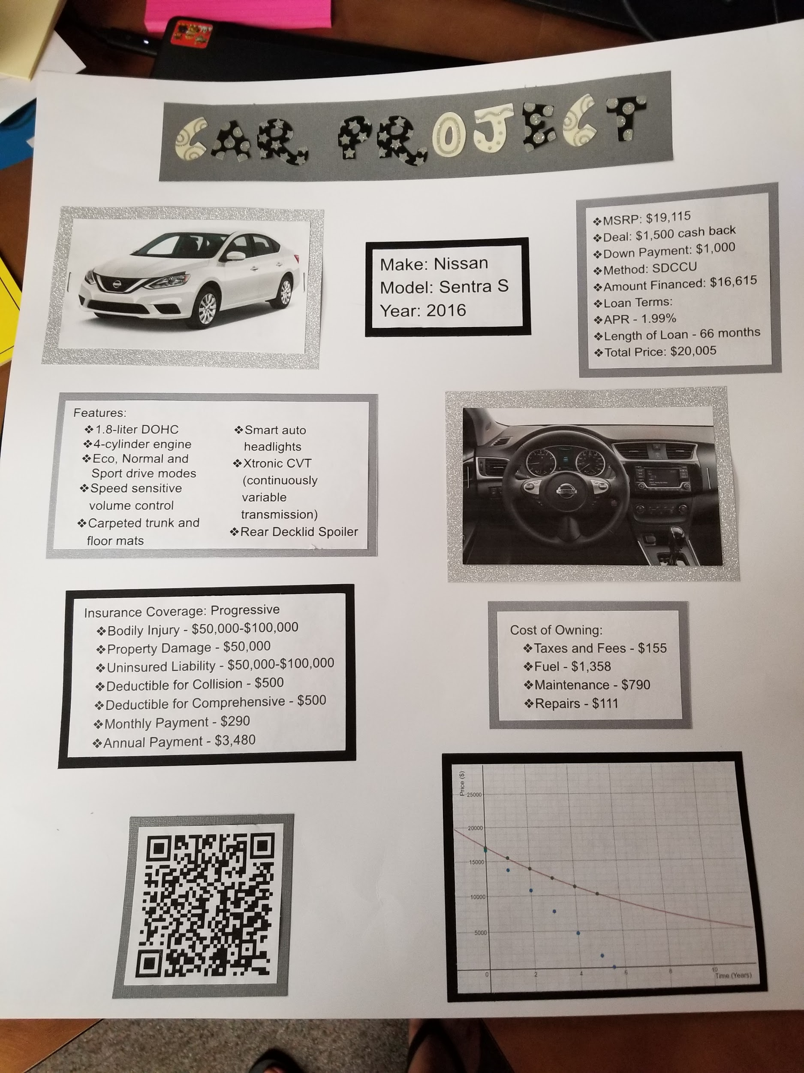
Example Posters

Slide 17
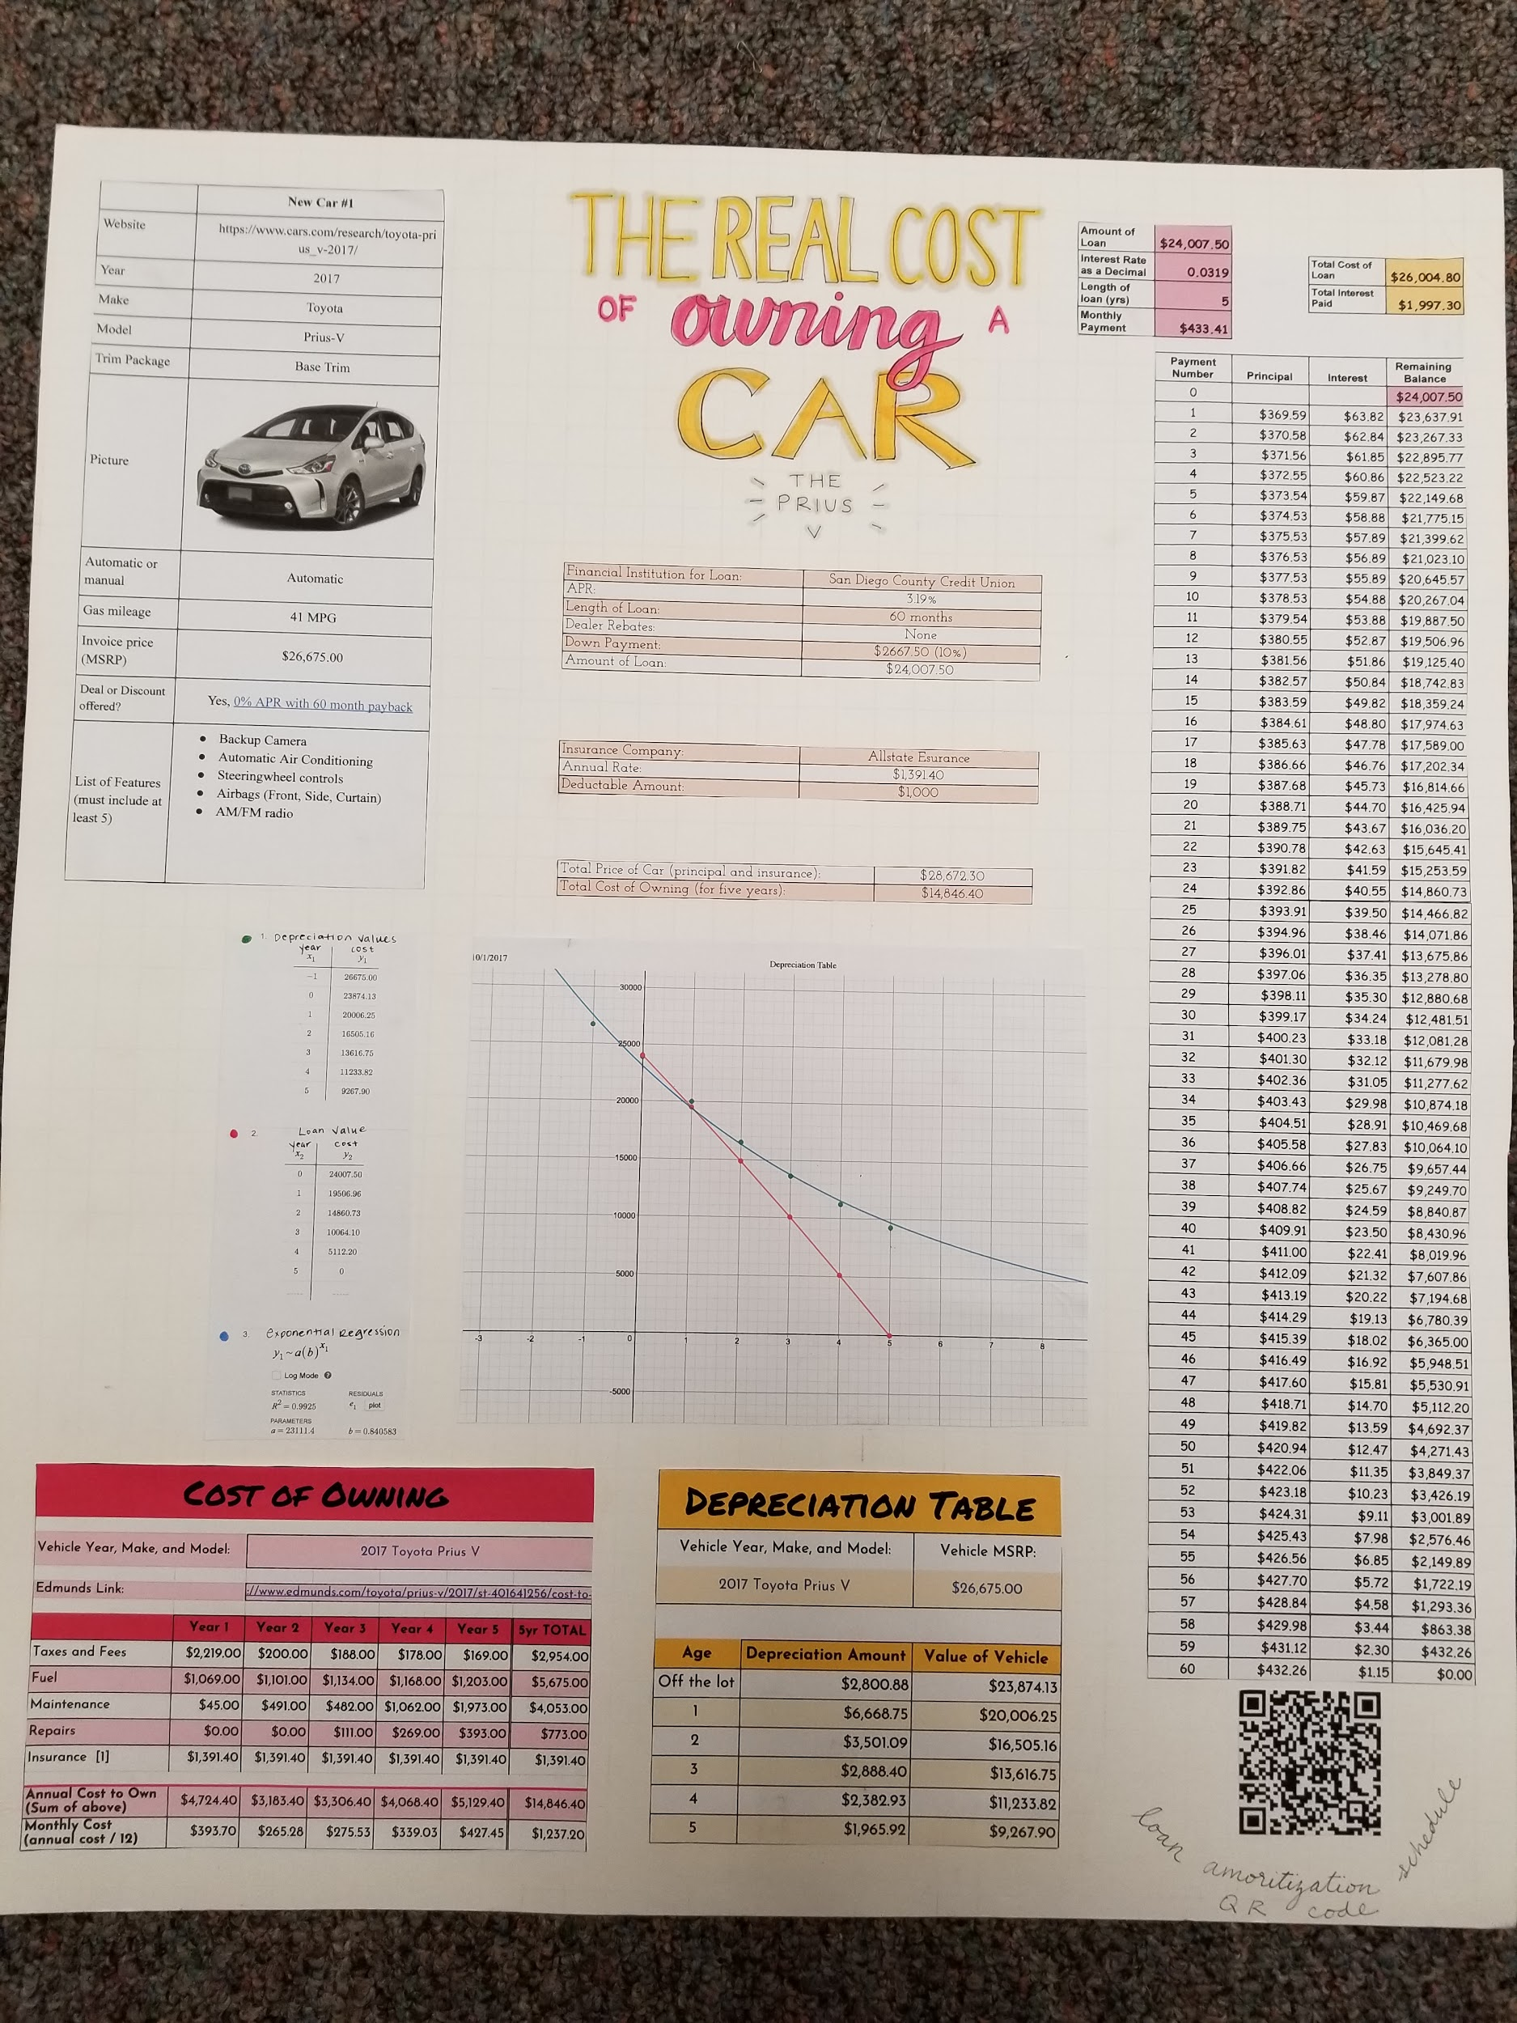

Slide 18
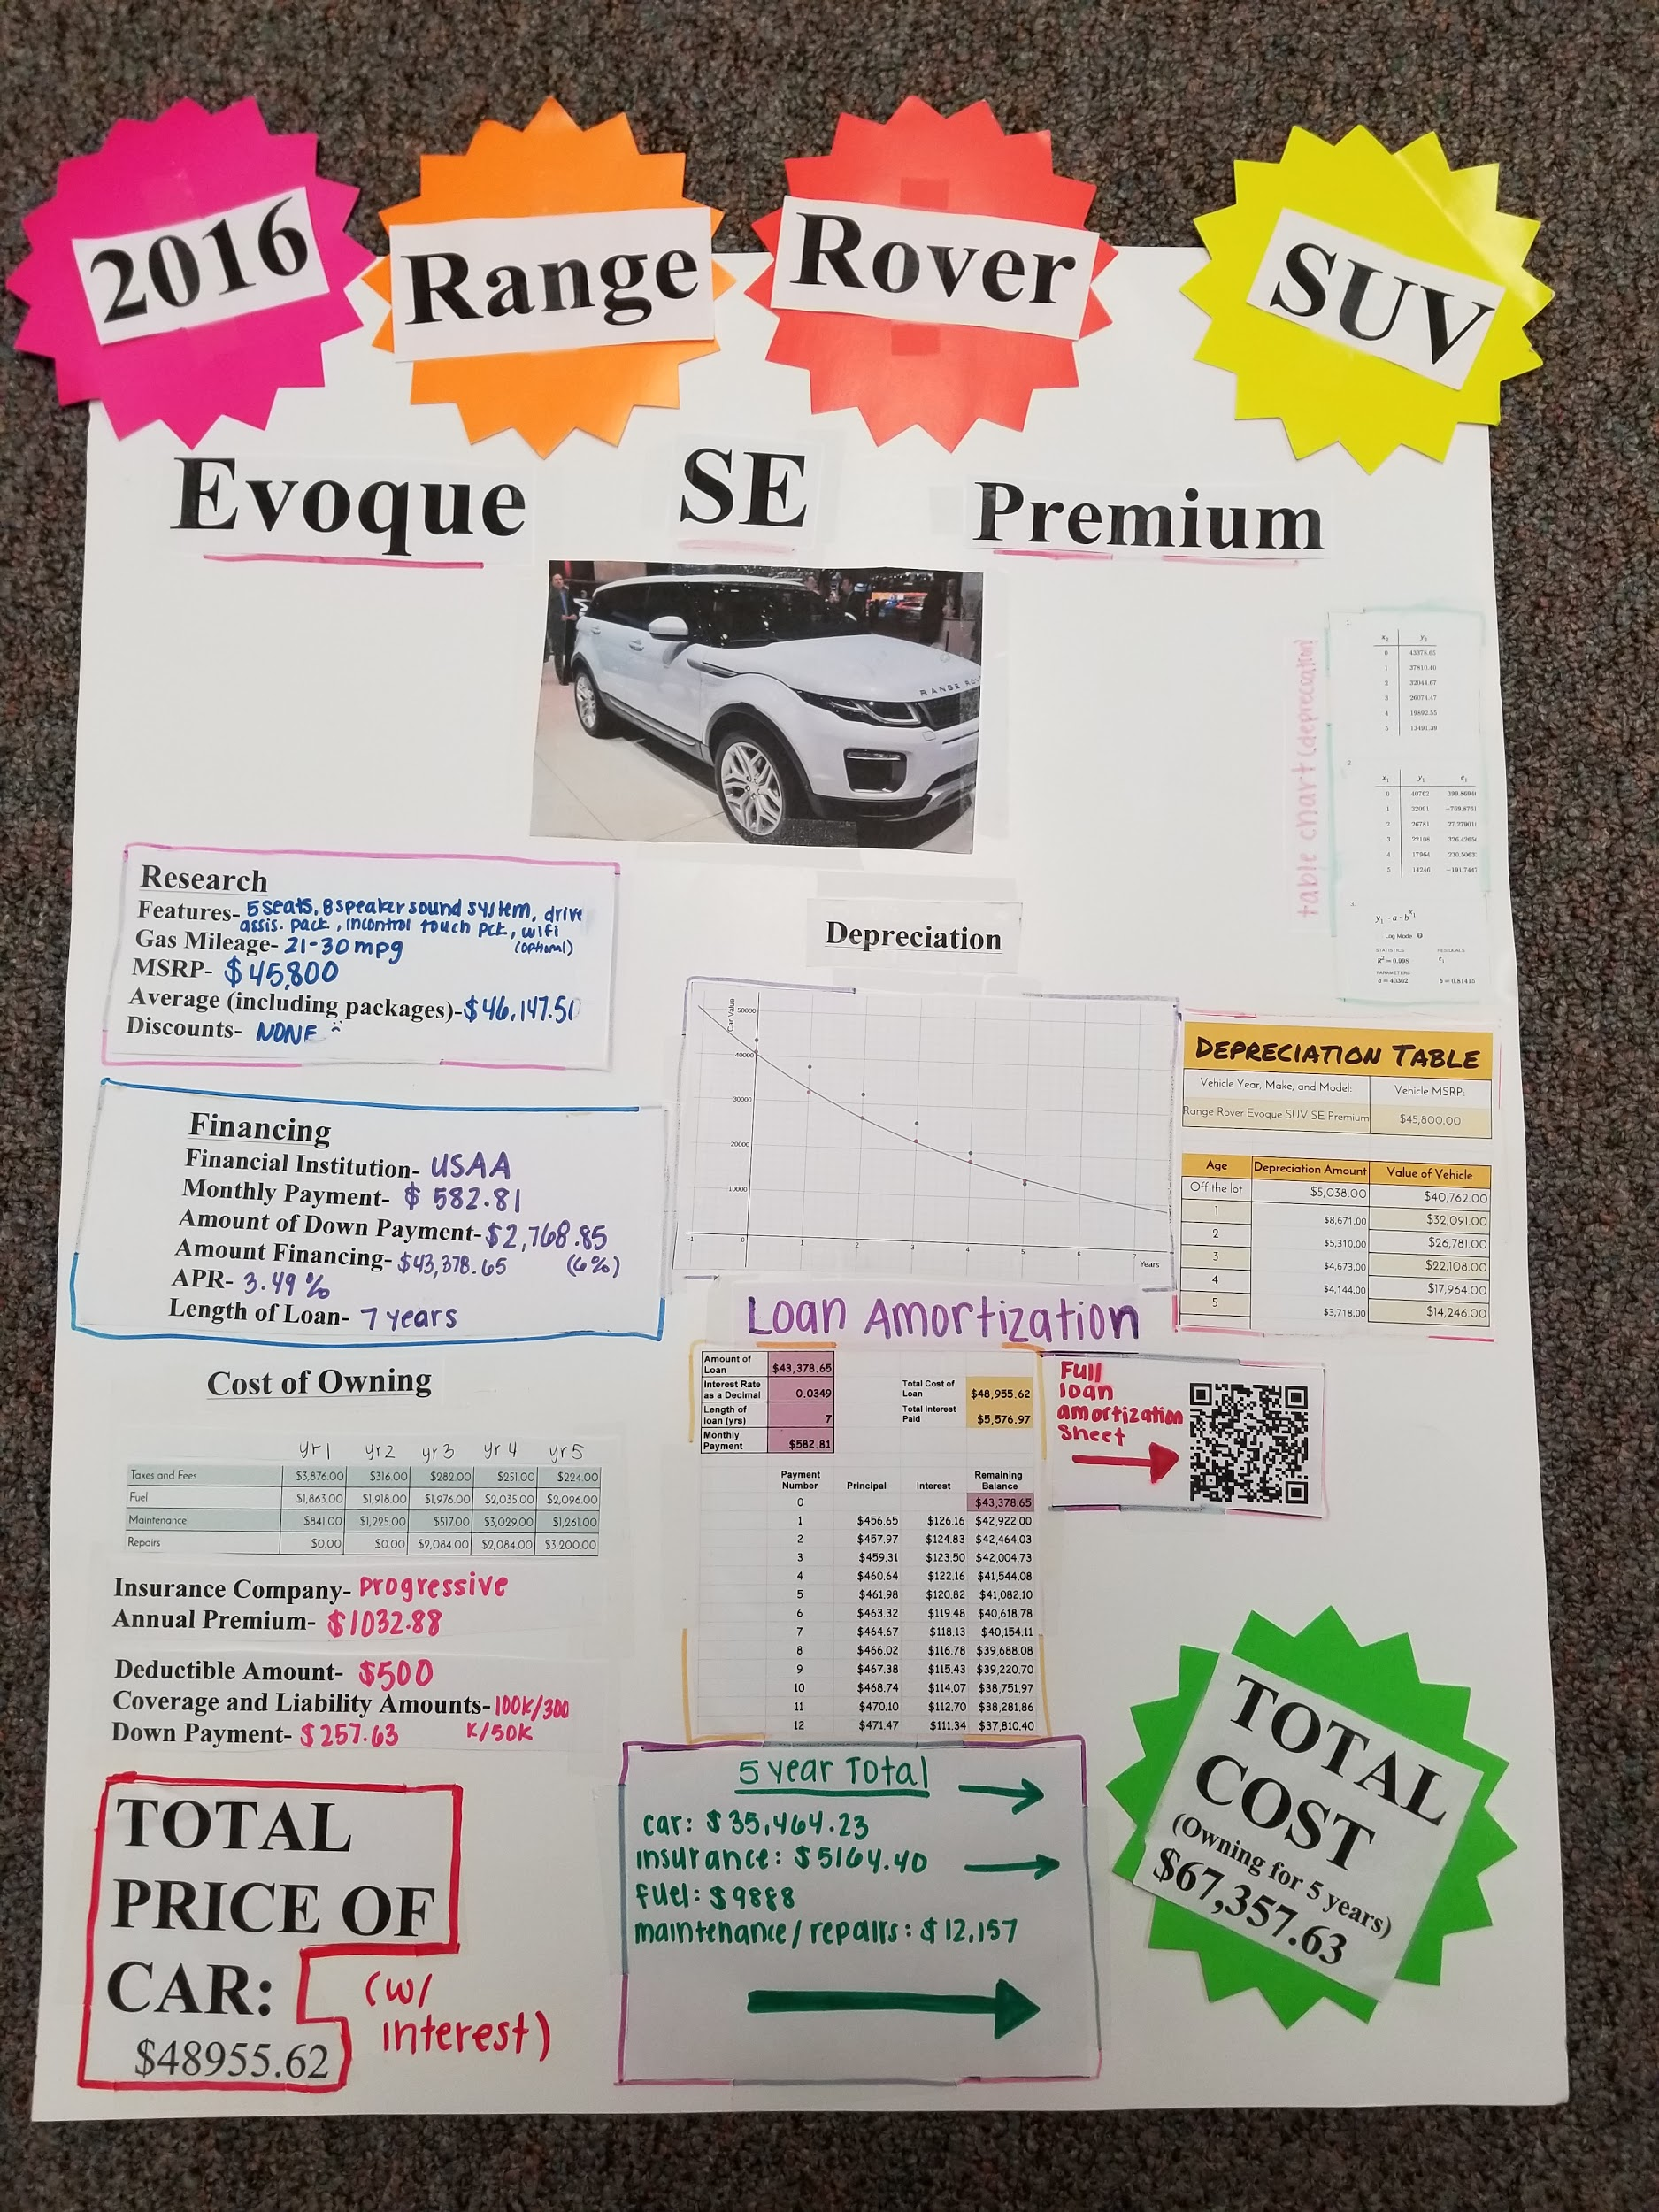

Slide 19
