Slide 1
8-1 FIND A PLACE TO LIVE
OBJECTIVES
Calculate the affordability of a monthly rent.
Determine the relationship between square footage and monthly rent.
Determine lease signing costs.

Slide 2
Key Terms
Tenant: person who rents a house or apartment.
Landlord: person or people that own a rented house or apartment
Security Deposit: money given to a landlord as protection in the event that the tenant causes damage to the property; refunded when tenant moves out if there is no damage.

Slide 3
Key Terms
Lease: a written agreement between the landlord and a tenant that details the amount of rent, the length of time the unit is to be rented, and the rules and regulations that must be followed.
Evict: legally forcing a tenant to leave a rental property for failure to pay rent or follow the rules and regulations of the lease.
Application Deposit: money that covers the cost of processing the application for the rental.

Slide 4
Where will you live?
Many options depending on how long you think you will live there for:
Dorm
Apartment
Condo/townhome
House
One can rent or purchase
Advantages and disadvantages to each

Slide 5
IMPORTANT
As a rule, people should budget between 25% and 30% of their gross monthly income for rent or housing expenses (good estimate is 28%).

Slide 6
Can Afford vs. Can Make Payments
Can Afford -
Falls within the recommended 25-30%
Safe estimate to afford additional living expenses (food, utilities, phone, internet, cable)
Can Make Payments -
More than recommended 30%
Make enough to pay housing each month
May not have money “leftover” each month
Will be in trouble if unexpected expense occurs

Slide 7
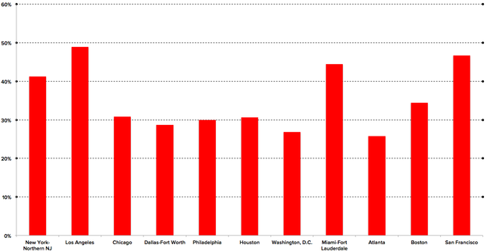
Percent of Income Spent on Rent (2015)
https://www.buzzfeed.com/jimdalrympleii/los-angeles-is-facing-a-housing-affordability-crisis?scrlybrkr=865c79fd&utm_term=.qovxz9jwYg#.qwP7rew3n9
Notes:
Jim Dalrymple via Zillow data: The graph below shows that renters in L.A. pay an average of 48.9% of their income on housing. By comparison, people in New York and northern New Jersey spend an average of 41.3% of their income on rent, while in San Francisco the average is 46.7%.

Slide 8
Household Income Spent on Housing (2013)
http://www.lao.ca.gov/reports/2015/finance/housing-costs/housing-costs.aspx

Slide 9
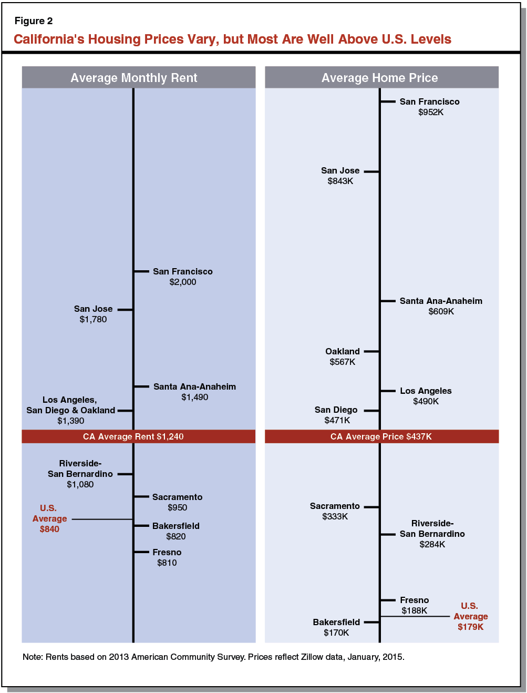
Average Monthly Housing (2015)
http://www.lao.ca.gov/reports/2015/finance/housing-costs/housing-costs.aspx

Slide 10
Shopping for a Rental
size
Often include the _______ of the apartment by listing the square ___________ of floor space in an ad.
footage

Slide 11
Abbreviations to Know
Abbreviation | What it is | Abbreviation | What it is
ba or bth |  | mint
br |  | renov
DW or D/W |  | rm
DR |  | stu
Drmn |  | spac
EIK |  | WIC
elev |  | W/D
gar |  | w/d hkup
h/w |  | w/w
htd |  | yd
Incl ht/hw

Slide 12
Rental Fees
deposit
Application _________ to pay for processing your application.
__________ deposit to cover any ___________ to the property.
Landlord may require ______ and ______ month’s rent to help protect them from you breaking the ________.
If you use a broker to find a place, there will be that _____ as well.
Security
damages
first
last
lease
fee

Slide 13
EXAMPLE 1
Joan makes $71,692 per year and pays about 25% of her gross monthly income in federal and state taxes. She wants to find an apartment to rent. Estimate how much she can afford to pay for rent each month. Then determine how much money she will have after taxes and rent are paid.

Slide 14
EXAMPLE 2
Caitlin’s monthly gross income is $4,340. She pays 22% of her monthly gross earnings in federal and state taxes and 11% for her student loan. Caitlin uses 9% of her monthly gross income to pay toward her credit card balance. She wants to rent an apartment that will cost $1,600 per month. Will she be able to make the payments without changing the amounts she pays toward her student loans and credit card balances?

Slide 15
EXAMPLE 3
Craig and Christina have both been offered new jobs in a different city. A real estate broker sent them a listing of apartments in their desired location showing the square footage in each apartment. Determine the price per square foot for each listing. What would be a good estimate for the amount of monthly rent charged for an 800-square foot apartment?

Slide 16
EXAMPLE 4
Daniel and Julienne paid a $300 application deposit for the 1,200-square foot apartment they are renting. They are required to provide a credit report that costs $20 and pay a security deposit equal to one month’s rent. The landlord also requires the last month’s rent at the time of signing the lease. The broker charged 8% of the yearly rent. How much should they expect to pay to be able to move into the apartment if their rent is $1,395 per month?

Slide 17
What to do?
Stock Portfolio Part TWO (due tonight)
8-1 Practice (due tomorrow)
Tracking and Graphing (due Friday)
Summary (due Friday)
Rental Research (due Monday)

Slide 18
What to do?
Stock Portfolio Part TWO (due tomorrow)
Take a screenshot of the 3 additional transactions (that have been COMPLETED)
Update prices and shares
8-1 Practice (due tomorrow)
Rental Research (due Monday)

