Slide 1
4-2
LOANS
Turn in your 4-1 Practice sheet, please!
Compute monthly payments using a formula.
Compute finance charges on loans.

Slide 2
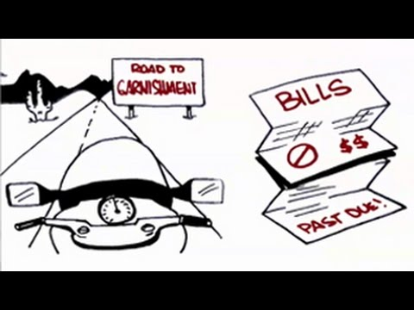
KEY TERMS
Vocabulary
PROMISSORY NOTE: An agreement which states the conditions of a loan; a borrower's signature confirms a promise to pay back the loan as outlined in the agreement.
PREPAYMENT PRIVILEGE: An agreement that allows the borrower to make payments before the due date to reduce the amount of interest.
WAGE GARNISHMENT: An involuntary form of wage assignment, often done by court order.

Slide 3
KEY TERMS
Vocabulary
BALLOON PAYMENT: The last monthly payment on some loans that is much greater than the previous payments.
COLLATERAL: Security, such as a personal belonging, car or boat title, CD, or stock certificates, that insures a loan will be paid. (i.e when you take a calculator from my back desk and leave a shoe, keys, ID, etc.)

Slide 4
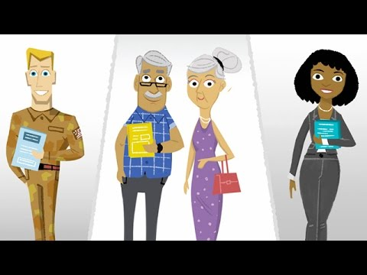
Car Financing

Slide 5
WHAT INFORMATION DO YOU NEED TO KNOW BEFORE TAKING OUT A LOAN?
Vocabulary
You sign a promissory note when you take out a loan
Read the fine print!!! Know what you are signing up for.

Slide 6
Vocabulary
What should you see on your promissory note?
Principal
Monthly payment
APR
Number of payments
Finance Charge
Due dates
Fees for late payments

Slide 7
COSIGNER
Vocabulary
When you don’t have a credit rating or you don’t have a good credit rating, sometimes a cosigner is required.
Cosigners agree to pay back the loan if the original debtor does not.
Some loans also require that you have life insurance, so that if you die, the loan can still be repaid.

Slide 8
Vocabulary
LENDING INSTITUTIONS
Banks | Savings Banks People use; good interest for people with good credit
 | Commercial Banks Businesses use; large amounts of money; need good credit
Credit Unions | For members only; loan interest rates usually lower than banks

Slide 9
Vocabulary
Consumer Finance Companies | Lend to people with bad credit; high interest rates
Life Insurance Companies | Loans for policyholders; good interest
Pawnshops | Small, quick loans; need to leave collateral

Slide 10
ACTS
Vocabulary
Truth in Lending Act: Requires creditors to state certain information before you sign a loan.
Equal Credit Opportunity Act: Requires a creditor to treat you fairly.
Fair Credit Reporting Act: The lender must give you the reason in writing for the loan denial.

Slide 11
EXAMPLE 1
What is the monthly payment for a $4,000 three-year loan with an APR of 10.25%?
Find the APR under the Rate column and the number of years that the loan will be for, where the two meet is what the monthly payment would be for a loan of $1,000. What is that number?
Since our loan is not for $1,000, figure out how many $1,000 increments there are in our loan. We divide our principal by $1,000.
Now we can multiply our answer by the amount we found in the table. This will give us our monthly payment using the table method.
11

Slide 12
EXAMPLE 2
What is the total amount of the monthly payments for a $4,000, three-year loan with an APR of 10.25%?
What is the amount for one monthly payment? (found in Example 1)
How many monthly payment are in this three year loan?
What is the sum of all the monthly payments?
12

Slide 13
EXAMPLE 3
Find the finance charge for a $4,000, three-year loan with a 10.25% APR.
What is a finance charge?
Find the finance charge of the loan referred to in Examples 1 and 2.
13

Slide 14
MONTHLY PAYMENT FORMULA
Vocabulary
( )
( )
( )

Slide 15
EXAMPLE 4
Elroy bought a new car. The total amount he needs to borrow is $29,126. He plans on taking out a 5-year loan at an APR of 6.23%. What is the monthly payment?
15

Slide 16
EXAMPLE 5
Judy bought a new dishwasher. The total amount she needs to borrow is $840. She plans to take out a 2-year loan at an APR of 4.2%. What is the monthly payment?
16

Slide 17
What can I do? (in order)
4-2 PRACTICE Worksheet
Vehicle Research (Due tomorrow)
Financing Part 1 (Due Thursday) Will post in a few minutes...
17

