Slide 1
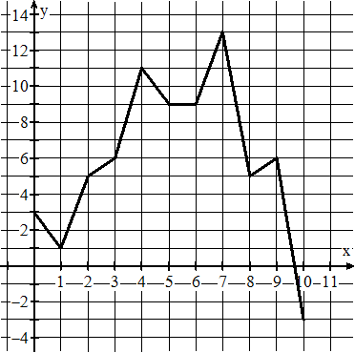
Module 0, Day 8
Have Out:
Homework, red pen, assignment sheet, highlighter, module, GP NB
The following graph represents the net worth (in millions of dollars) of instasnap.com over a 10-year period beginning in 2000. Answer the following:
Bellwork:
1. Is this a function? Explain your reasoning within the context of the problem.
2. What are the maximum and minimum values? What do they mean in context?
3. Identify the domain and explain what it means within the context of the problem.
4. Identify the range and explain what it means within the context of the problem.
Net worth (in millions)
5. What is the y-intercept? What does it mean in context?
6. Which interval has the greatest rate of change? Explain your reasoning in context.
# of years
7. Describe the context of the situation on the interval [4, 7].

Slide 2
1. Is this a function? Explain your reasoning within the context of the problem.
+1
Yes this is a function because there can only be a single amount of net worth at any given time.
+1
Net worth (in millions)
2. What are the maximum and minimum values? What do they mean in context?
The maximum is a net worth of 13 million dollars in 2007.
+1
+1
The minimum is NEGATIVE 3 million dollars in 2010 (this means they are bankrupt and OWE money!)
# of years
+1
3. Identify the domain and explain what it means within the context of the problem.
+1
Domain is [0, 10] or {x| 0 ≤ x ≤ 10}
+1
The company is worth something during all years 2000-2010.
4. Identify the range and explain what it means within the context of the problem.
+1
Range is [-3000000, 13000000] or {y| -3,000,000 ≤ y ≤ 13,000,000}
The company is worth anywhere between -3 million and 13 million dollars in the ten year period.
+1

Slide 3
5. What is the y-intercept? What does it mean in context?
+1
y intercept is (3000000, 0)
On the last day of the year, there were no cars left in inventory.
+1
Net worth (in millions)
6. Which interval has the greatest rate of change? Explain your reasoning in context.
The greatest rate of change is on the interval (9, 10].
+1
This portion of the graph has the steepest slope and shows that the company’s net worth was no longer valuable.
# of years
+1
7. Describe the context of the situation on the interval [4, 7].
+1
From 2004-2005, the company’s net worth drops 2 million dollars. From 2005-2006, the net worth doesn’t change. From 2006-2007, the company’s net worth climbs 4 million.
+1
+1

