Slide 1
Have Out:
Homework, red pen, pencil, assignment sheet, highlighter, module
M3D5
Bellwork:
In 2016, the price for gas is $4 per gallon and it rises 6% per year.
1. Write an equation to model the cost of gas as a function of time.
This is an exponential problem!
Multiplier: 1.06
$$G\left(t\right)=4{(1.06)}^{t−2016}$$
+1
+1
+1
2. According to this model, what did it cost in 1982?
3. According to this model, what will you expect it to cost halfway through 2017?

Slide 2
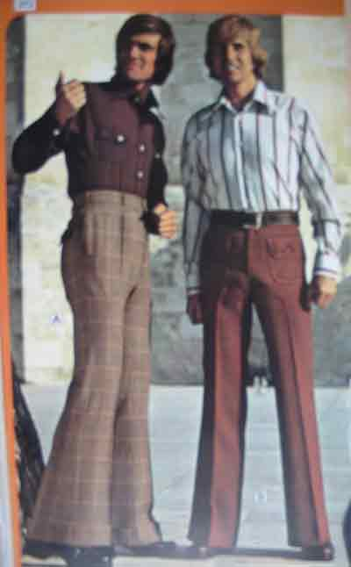
In 2015, the price for gas is $4 and it rises 6% per year.
1. Write an equation to model the cost of gas as a function of time.
$$G\left(t\right)=4{(1.06)}^{t−2016}$$
+1
+1
+1
2. According to this model, what did it cost in 1982?
$$G\left(1982\right)=4{(1.06)}^{1982−2016}$$
+1
+1
+1
WOW 55 CENTS for a gallon of gas! Those were the days!
$$G\left(1982\right)=4{(1.06)}^{−32}$$
$$G\left(1982\right)≈0.55$$
+1
3. According to this model, what will you expect it to cost halfway through 2017?
$$G\left(2017.5\right)=4{(1.06)}^{2017.5−2016}$$
+1
$$G\left(2017.5\right)=4{(1.06)}^{1.5}$$
+1
+1
$$G\left(2017.5\right)≈4.37$$
+1
It will cost about $4.37 for a gallon of gas!

